Slide 1
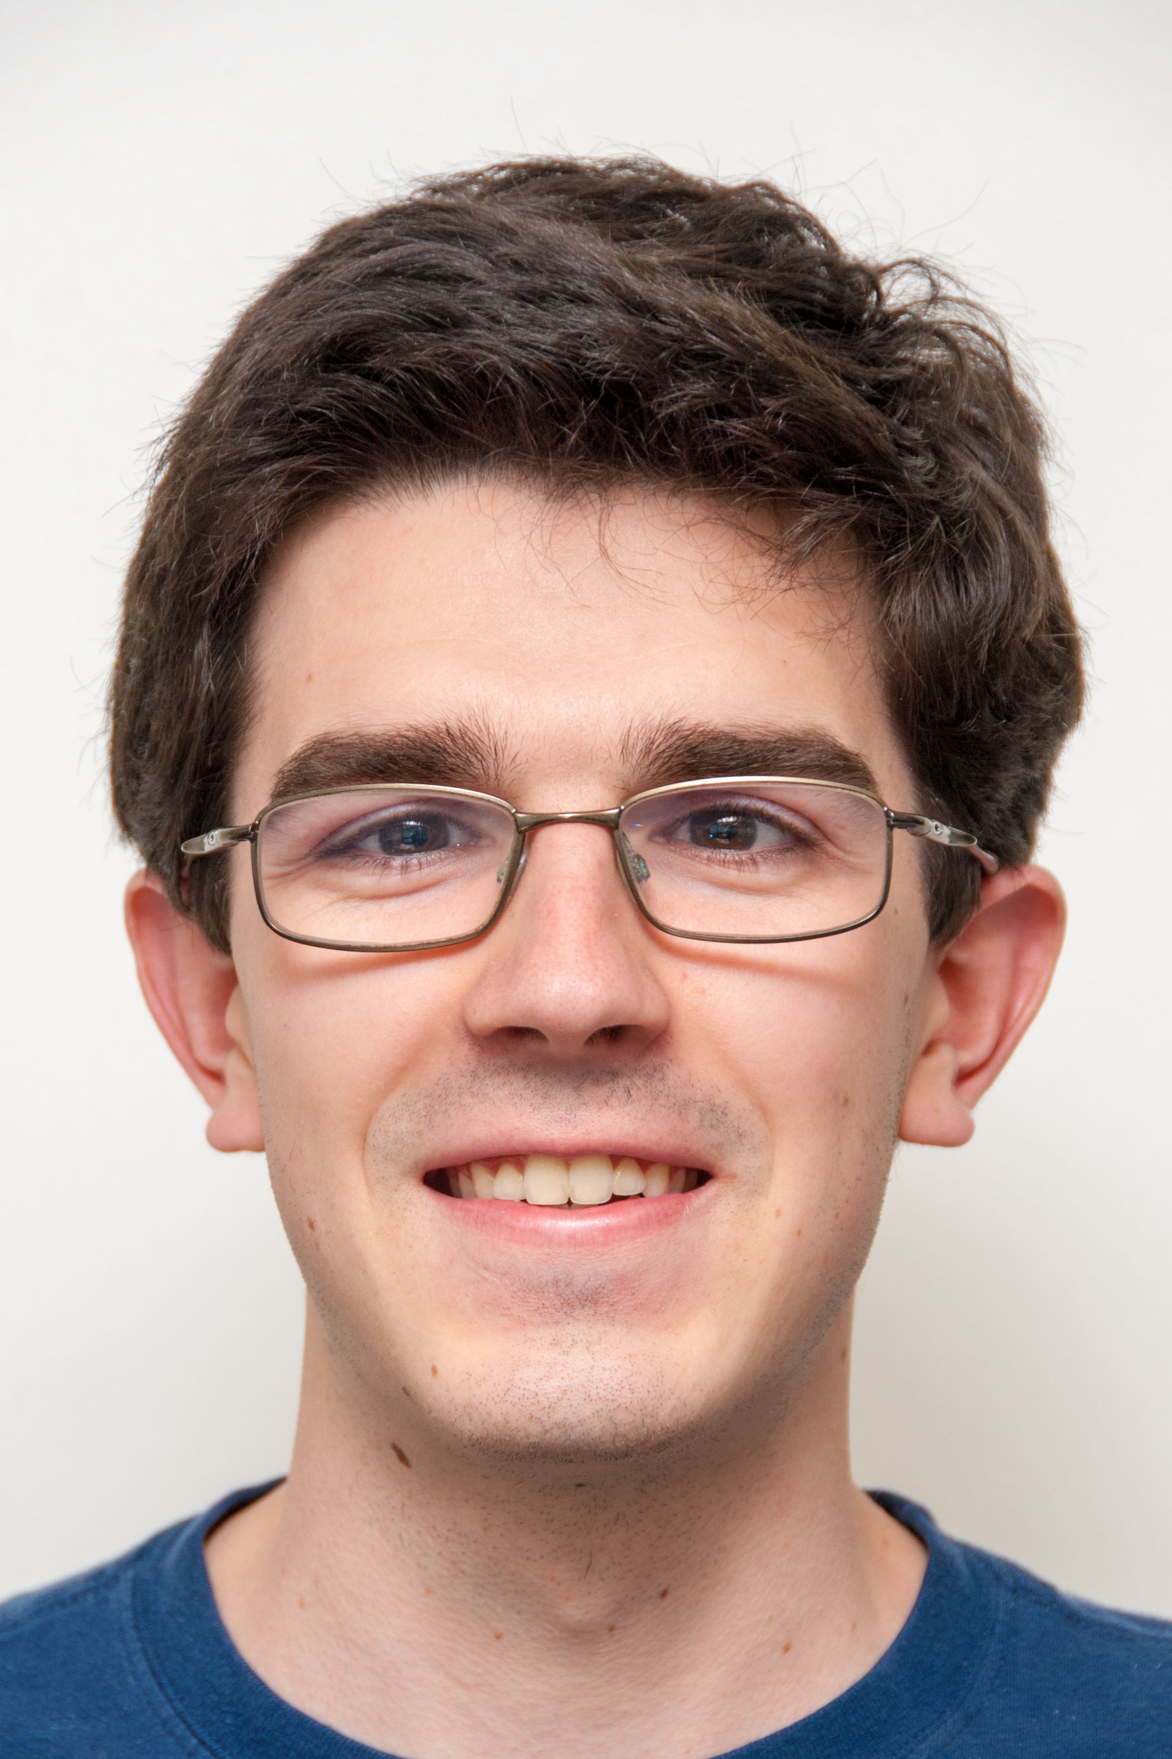


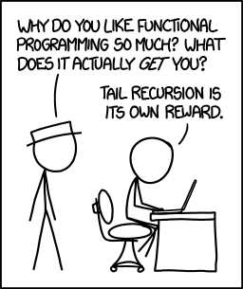
Chip Design Savings from Functional Language?
The Beauty and Joy of Computing Lecture #2 Functions
Michael Ball
A new functional language (you’ll learn what that means today) “makes it possible a chip design transformation is completely error-free”. Huge potential cost-savings!
“Functional Programming is not part of the standard curriculum”. It is alive and well in Snap!, yay!
(xkcd.com/1270)
www.utwente.nl/en/newsevents/!/2015/1/167544/massive-chip-design-savings-to-be-realized

Slide 2
When Do You Learn Things in CS10?
Lecture
Computing in the News + Discussion
Big ideas, Inspiring Introductions, Demos
NOT THE CODING DETAILS
Lab, Homework, Projects
Coding, Collaboration, Deep Learning
Reading
Context, Impact of Computing, Current Events
Discussion
Clarify week’s material, Unplugged Activities

Slide 3
Office Hours and Discussions
You can go to as many office hours and discussions as you wish!
You’re not just limited to your TA
Please check the schedule on cs10.org, as that will have the currently correct times.
My OH – right after lecture on Tues (5-6pm), before lecture on Thurs (3-4pm)

Slide 4
Function Basics

Slide 5
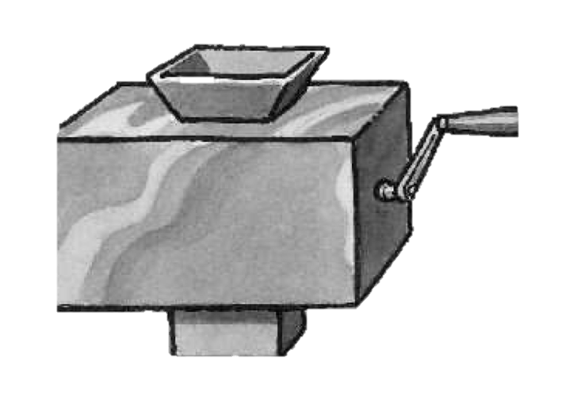
Abstraction: Generalization REVIEW
You are going to learn to write functions, like in math class:
y = plus5(n)
plus5 is the function
n is the input, a number
It returns a single value, here a number 5 more than the input.
n
plus5
Function machine (Simply Scheme, Harvey)

Slide 6
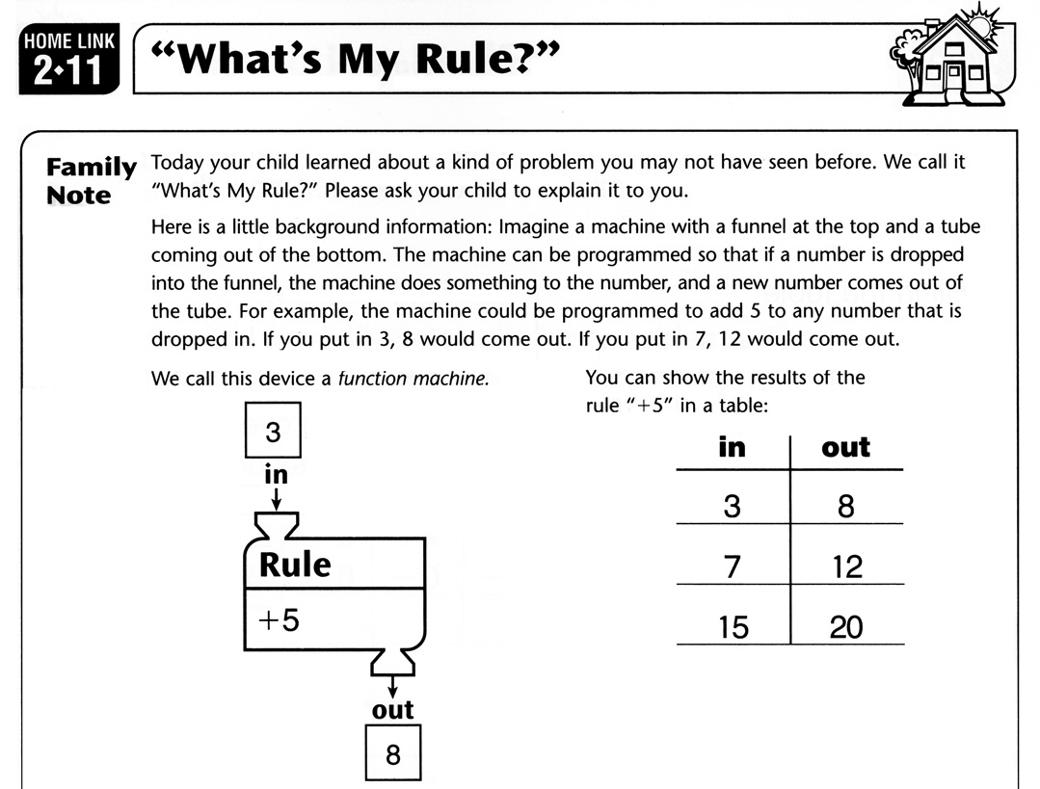
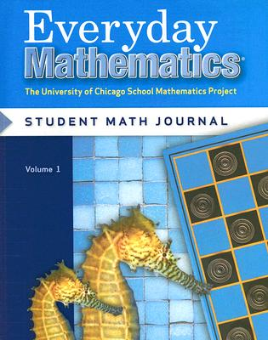
Functions in 2nd Grade Math Curricula!

Slide 7
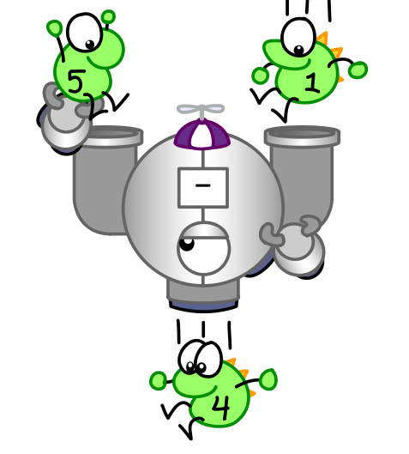
Function Definition
Functions take in 0 or more inputs, return exactly 1 output
The same inputs MUST yield same outputs.
Output function of input only
Other rules of functions
No state (prior history)
No mutation (no variables get modified)
No side effects (nothing else happens)
Function Metaphor
(CS Illustrated, Ketrina Yim)

Slide 8
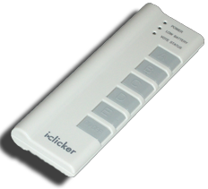
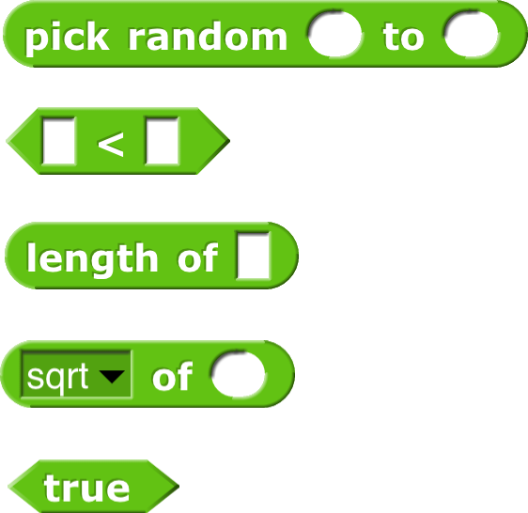
Which is NOT a function?

Slide 9
Data Types Domain & Range

Slide 10
Basic Data Types (You’ll make more)
Sentences
E.g., CS 10 is great
Word
Cal, 42, CS10
E.g., A, 3, #
Letter
E.g., h
A-Z,a-z only
Character
Length = 1
Words separated by N spaces, N ≥ 0
Length ≥ 1, no spaces

Slide 11
Domain and Range (from Math)
Domain
The “class” of input a function accepts
Examples
Sqrt of
Non-negative numbers
Length of
Sentence, word, number
_ < _
Sentence, word, number
_ and _
Boolean
Range
All the possible return values of a function
Examples
Sqrt of
Non-negative numbers
Length of
Non-negative integer
_ < _
Boolean (true or false)
_ and _
Boolean (true or false)

Slide 12

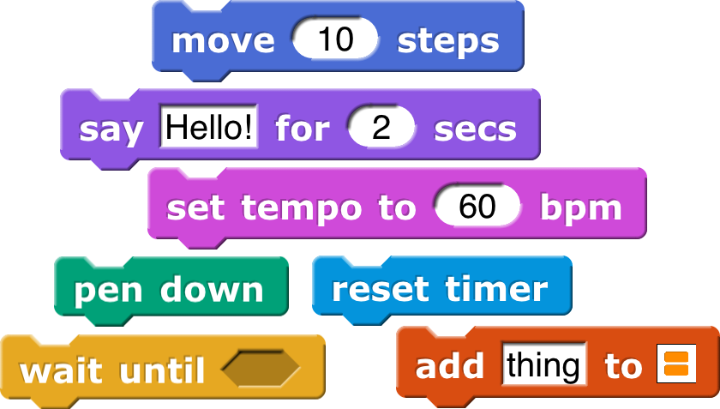
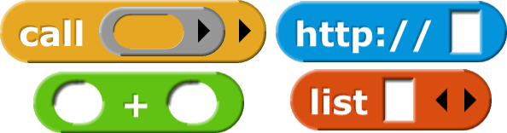
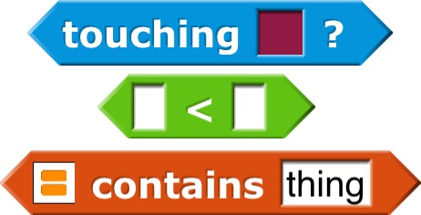
Types of Blocks in
Procedures, Subroutines
Command
No outputs, meant for side-effects
Not a function…
Reporter (Function)
Any type of output
Predicate (Function)
Boolean output
(true or false)

Slide 13

Domain, Range of…
Domain Range
Integer ≥ 1, Number Digit
Integer ≥ 1, Word Letter
Integer ≥ 1, Word Character
Integer ≥ 1, Sentence Letter
Integer ≥ 1, Sentence Character

Slide 14
Why Should You Use Functions?

Slide 15
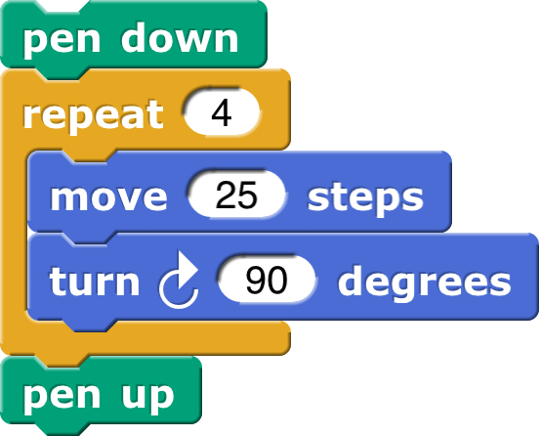
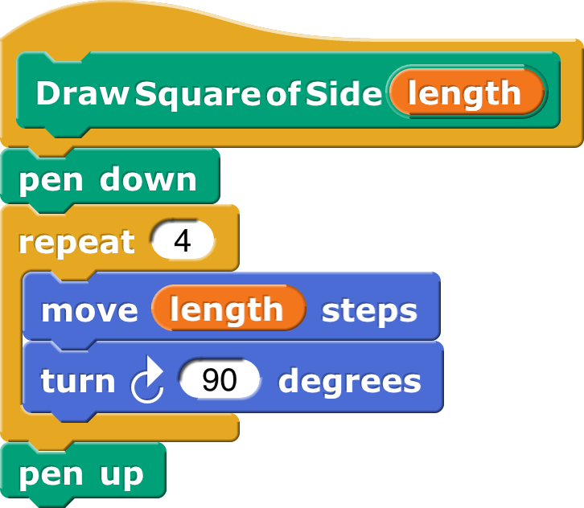
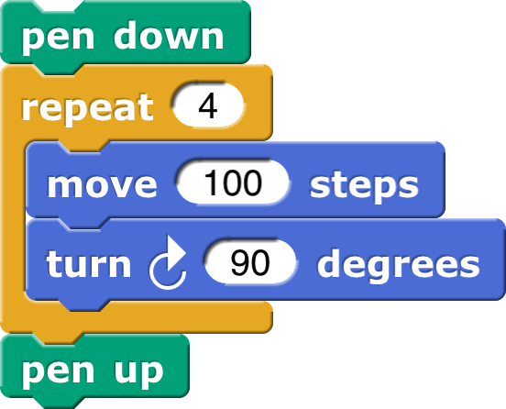
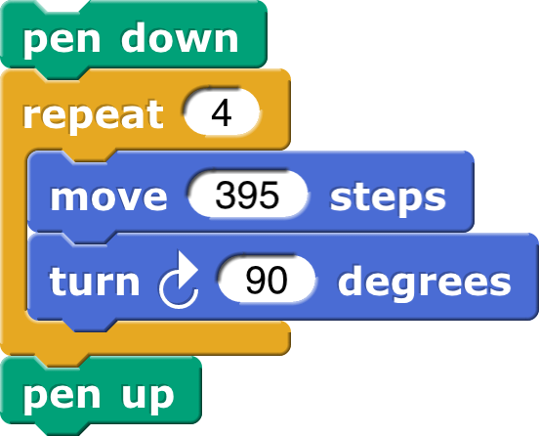
Why Use Functions? (1/3)

Slide 16
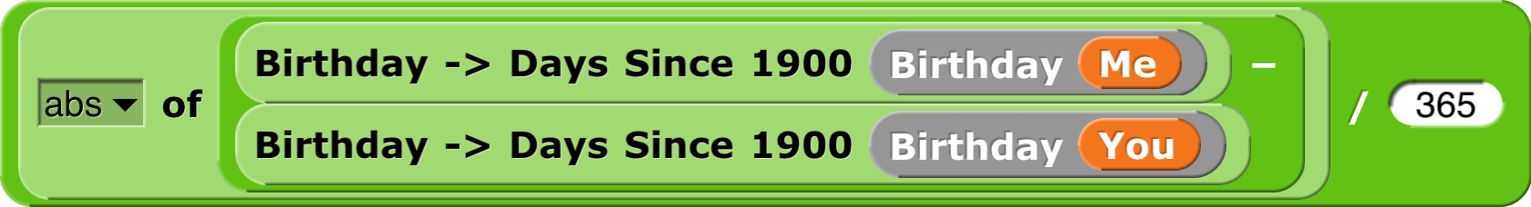
Why Use Functions? (2/3)
They allow for generalization of code!
The building blocks of our programs
They can be composed together to make even more magnificent things.
Breaking big problems down into smaller ones is functional decomposition

Slide 17
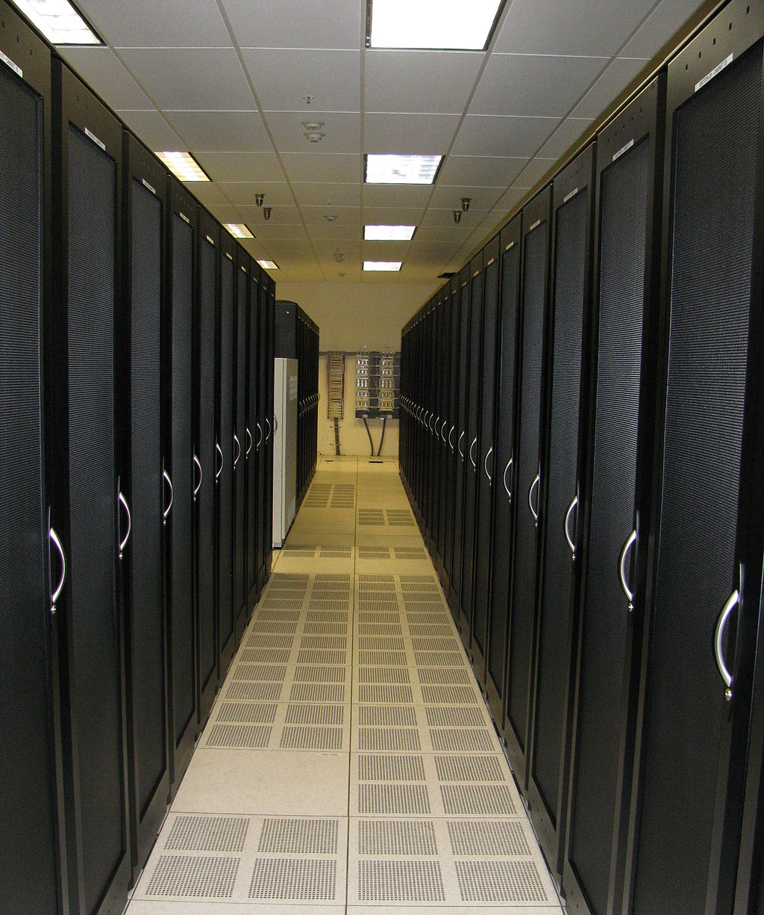
Why Use Functions? (3/3)
en.wikipedia.org/wiki/Functional_programming
If a function only depends on the information it gets as input, then nothing else can affect the output.
It can run on any computer and get the same answer.
This makes it easy to parallelize computation.
Functional programming is a great model for writing software that runs on multiple systems at the same time.
Cabinet Aisle in a Datacenter (Wikipedia, Robert Harker)

Slide 18
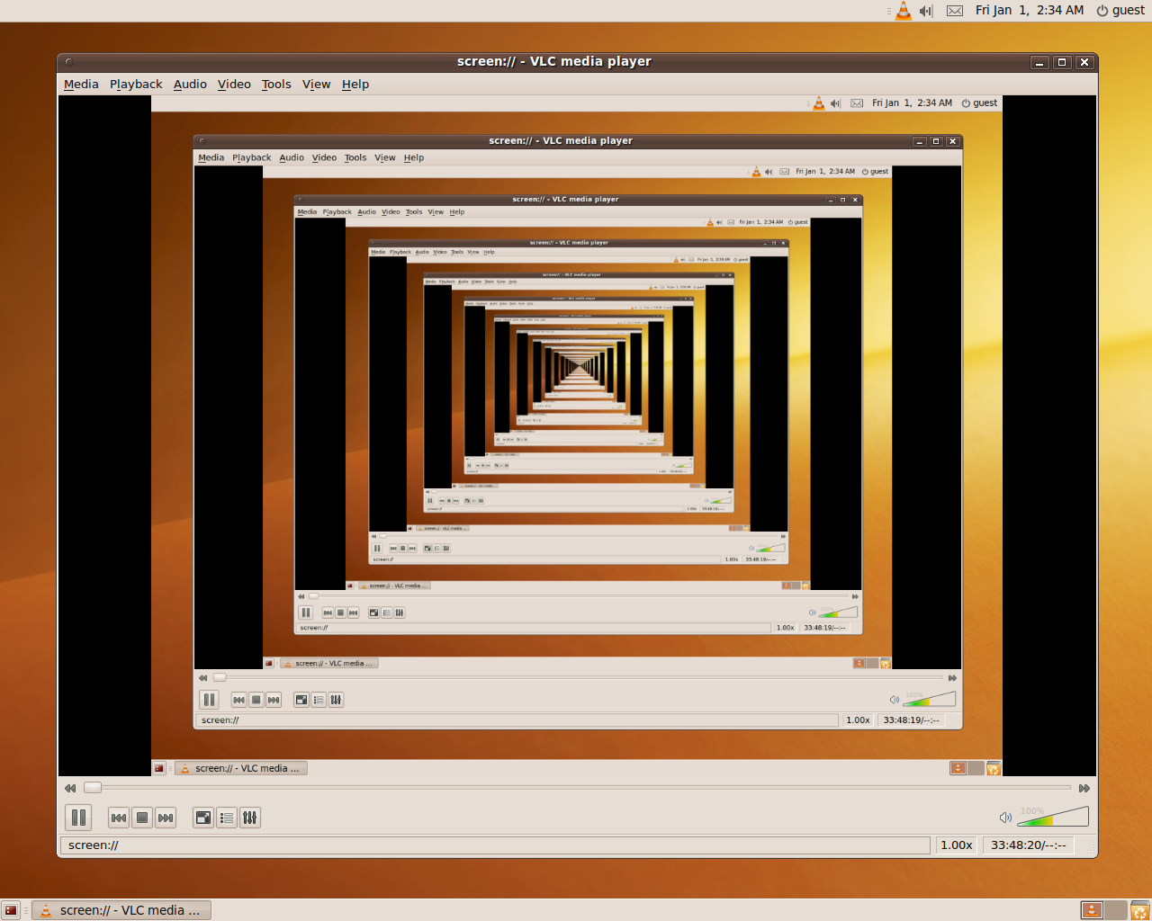
Quick Preview: Recursion
Recursion is a technique for defining functions that use themselves to complete their own definition.
This is one of our Big Ideas!
Recursion in Screen Recording Program (Wikipedia, Hidro)
☑

Slide 19
Functions Demo!

Slide 20
Functions Summary
Abstraction: Generalization
Computation is the evaluation of functions
Plugging pipes together
Function: ≥ 0 inputs, 1 output
Functions can be input!
Features
No state
E.g., variable assignments
No mutation
E.g., changing variable values
No side effects
E.g., nothing else happens
f(x)=(x+3)* x
x
x 3
x
+
f
*

